Slide 1

Professional Practices (HUM-305)
SPRING SEMESTER 2026
By
Prof Engr Muhammad Raheel Iqbal Butt
Resource Person
Contact: +92 321 7433568
School of Computer & Information Technology
Beaconhouse National University, Lahore

Slide 2


Slide 3
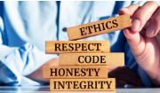
Chap 1: Introduction to Professional Practices & What Is Ethics?
What Is Ethics?
A Variety of Ethical Views
Some Important Distinctions
E-commerce and Free Stuff
Artificial Intelligence, Robotics, Sensors, and Motion

Slide 4
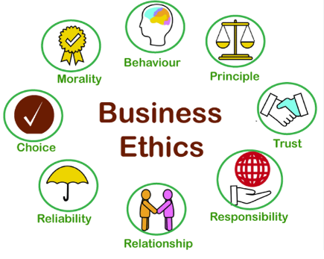

Slide 5
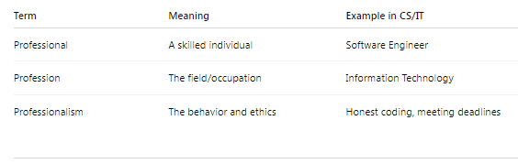
Difference Between Professional, Profession & Professionalism

Slide 6
Professional
Definition:
A professional is a person who has specialized education, training, and skills in a particular field and applies them competently and ethically to earn a livelihood.
Key Characteristics:
Specialized knowledge
Formal education or certification
Practical skills
Ethical behavior
Responsibility and accountability

Slide 7
Professional
CS / IT Example:
A Software Engineer working at Google.
A Cybersecurity Analyst protecting data in a bank.
A Network Administrator managing servers in an organization.
Example:
If a Software Developer designs secure applications, meets deadlines, and follows ethical coding standards, he/she is acting as a professional.

Slide 8
Profession
Definition:
A profession is an occupation that requires specialized education, training, intellectual skills, and adherence to a code of ethics.
Key Elements:
Formal qualification (degree/certification)
Professional standards
Code of ethics
Continuous learning
Service to society

Slide 9
Profession
Examples of Professions:
Medicine
Law
Engineering
Teaching
Computer Science / IT
CS / IT as a Profession:
Computer Science became a recognized profession because:
It requires formal education (BSCS, MSCS, Certifications).
It follows ethical guidelines (like privacy and data protection).
It serves society (software systems, healthcare systems, AI, banking systems).

Slide 10
Profession
Example:
Working as a Data Scientist at Microsoft is part of the IT profession because it involves specialized skills and ethical responsibilities

Slide 11
Professionalism
Definition:
Professionalism refers to the behavior, attitude, and standards expected from a professional while performing their duties.
It is about how a professional behaves, not just what they know.
Core Components of Professionalism:
Competence
Integrity
Accountability
Respect
Ethical behavior
Communication skills
Time management

Slide 12
Professionalism
Professionalism in CS / IT (Detailed Explanation)
1: Technical Competence
Writing clean and secure code.
Using correct algorithms and data structures.
Testing software properly before deployment.
Example: A developer ensures software has no major security vulnerabilities before release.

Slide 13
Professionalism
2: Ethical Responsibility
Following ethical codes such as those from Association for Computing Machinery (ACM Code of Ethics).
Ethical issues in IT:
Data privacy
Intellectual property
Plagiarism
Cybercrime
AI bias
Example: A database administrator does not misuse users' personal data.
3️⃣ Accountability
Taking responsibility for errors.
Fixing bugs promptly.
Not blaming others.
👉 Example: If a system crashes due to your code, you accept responsibility and fix it.
4️⃣ Communication
Explaining technical issues to non-technical clients.
Writing proper documentation.
Team collaboration.
👉 Example: A Project Manager clearly explains software requirements to developers.
5️⃣ Continuous Learning
IT changes rapidly:
Artificial Intelligence
Cloud Computing
Cybersecurity
Blockchain
A professional must update skills regularly.
👉 Example: A developer learns new frameworks like React or new programming languages.

Slide 14
Professionalism
2: Ethical Responsibility
Following ethical codes such as those from Association for Computing Machinery (ACM Code of Ethics).
Ethical issues in IT:
Data privacy
Intellectual property
Plagiarism
Cybercrime
AI bias
Example: A database administrator does not misuse users' personal data.

Slide 15
Professionalism
3: Accountability
Taking responsibility for errors.
Fixing bugs promptly.
Not blaming others.
Example: If a system crashes due to your code, you accept responsibility and fix it.
4: Communication
Explaining technical issues to non-technical clients.
Writing proper documentation.
Team collaboration.
Example: A Project Manager clearly explains software requirements to developers.

Slide 16
Professionalism
5: Continuous Learning
IT changes rapidly:
Artificial Intelligence
Cloud Computing
Cybersecurity
Blockchain
A professional must update skills regularly.
Example: A developer learns new frameworks like React or new programming languages.

Slide 17
Difference Between Professional, Profession & Professionalism

Slide 19
Ethics
Ethics, the discipline concerned with what is morally good and bad and morally right and wrong. The term is also applied to any system or theory of moral values or principles.
Ethics deals with such questions at all levels. Its subject consists of the fundamental issues of practical decision making, and its major concerns include the nature of ultimate value and the standards by which human actions can be judged right or wrong.

Slide 20
Ethics
The terms ethics and morality are closely related. It is now common to refer to ethical judgments or to ethical principles where it once would have been more accurate to speak of moral judgments or moral principles.
These applications are an extension of the meaning of ethics. In earlier usage, the term referred not to morality itself but to the field of study, or branch of inquiry, that has morality as its subject matter.
In this sense, ethics is equivalent to moral philosophy.

Slide 21
Ethics
1. What Is Ethics?
Ethics is a systematic study of moral principles that govern human behavior and decision-making. It helps individuals and organizations determine what actions are right, wrong, fair, or unjust.
Key Elements of Ethics
Values: Honesty, integrity, fairness, responsibility
Moral reasoning: Logical thinking about moral problems
Accountability: Taking responsibility for decisions and outcomes
Ethics in Professional and Business Life
Guides managerial decisions beyond legal requirements
Builds trust, reputation, and social responsibility
Helps manage conflicts between profit and societal welfare
Example
A company may legally sell customer data, but ethically it should obtain informed consent and ensure data protection.

Slide 22
Ethics
Although ethics has always been viewed as a branch of philosophy, its all-embracing practical nature links it with many other areas of study,including anthropology, biology, economics, history, politics, sociology, and theology.
Yet, ethics remains distinct from such disciplines because it is not a matter of factual knowledge in the way that the sciences and other branches of inquiry are.
Rather, it has to do with determining the nature of normative theories and applying these sets of principles to practical moral problems.

Slide 23
Ethics
This article, then, will deal with ethics as a field of philosophy, especially as it has developed in the West.
For coverage of religious conceptions of ethics and the ethical systems associated with world religions, see Buddhism; Christianity; Confucianism; Hinduism; Jainism; Judaism; Sikhism.
There are so many branches of philosophy and ethics is one of the branch of philosophy and in ethics we teach what is right and wrong.

Slide 24
Relationship between Ethics & Philosophy
Now Ethics and Morality difference is majorly lies on what is right and wrong
Example Six and Nine 69, moral or immoral but still difference occurs.
First origin of morality come from the term “MORES” which means “Customs and Traditions”
Every society has its own morality and it has its own dos and dosnt
Morality origin based upon customs and traditions that is why Greek philosopher used moral or social term as interchangeably.

Slide 25
Relationship between Ethics & Philosophy
Morality is our customs and traditions means a way of life .
Now we are heading towards similarity between ethics and molarity from both perspectives what is right and wrong but the fundamental difference of ethics or molarity is Ethics is conscious intellectual enterprise means consciously critical thinking.
Ethics is a parameter or standards to check the morality.
Any society / State customs or tradition dowry / triple talaq, it’s a part of molarity. Is is based on rationality or reasonably.
If we need thinking on it we required ethics so ethics is called to be rational thinking.

Slide 26
Relationship between Ethics & Philosophy
How origin of ethics come?
The origin of ethics come from molarity and molarity origin come from religion because first source of right and wrong is religion but with the passage of time human start making questions on culture practices which is based on religion, doing mind application and do critical thinking and this is how the origin of ethics come.
Sometime some things might be ethical or some are rational but in particular society there will be no acceptability e.g
MEN = WOMEN treat equally but social morality says something else.
In Nutshell morality is a part & parcel of any society we can see molarity in social norms do’s and dosnt but the philosopher using their intellectual curiosity / Intellectual & critical power they go for analysis, if something is moral but it is rational also, it has to be practical and it has to be rejected.

Slide 27
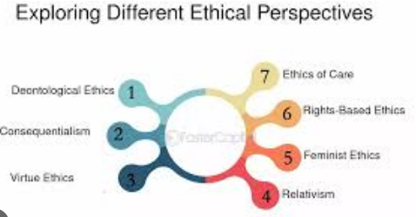

Slide 28
A Variety of Ethical Views
Different ethical theories provide different lenses for moral decision-making:
a) Utilitarianism
Proposed by Jeremy Bentham and John Stuart Mill
Judges actions based on outcomes or consequences
Ethical if it maximizes overall happiness or benefit
Strengths
Practical and result-oriented
Useful for public policy and business decisions
Limitations
May ignore minority rights
Difficult to measure happiness accurately

Slide 29
A Variety of Ethical Views
b) Rights-Based Ethics
Emphasizes basic human rights
Certain actions are unethical regardless of outcomes
Common Rights
Right to privacy
Right to freedom of expression
Right to informed consent
Limitation
Conflicts arise when rights compete

Slide 30
A Variety of Ethical Views
c) Justice and Fairness Approach
Focuses on equitable treatment
Based on theories of John Rawls
Principles
Equal opportunities
Fair distribution of resources and risks
Application
Used in HR policies, wage systems, and access to technology.

Slide 31
A Variety of Ethical Views
d) Virtue Ethics
Originates from Aristotle
Focuses on moral character rather than rules or outcomes
Key Virtues
Honesty
Courage
Responsibility
Compassion
Limitation
Less guidance in complex ethical dilemmas

Slide 32
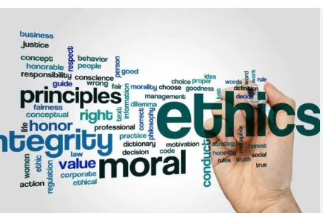

Slide 33
Some Important Distinctions
Understanding ethics requires distinguishing between key concepts:
a) Ethics vs Law
Law: Minimum standards enforced by government
Ethics: Higher moral standards, not always legally required ✔ Something can be legal but unethical
b) Ethics vs Morality
Morality: Personal or cultural beliefs
Ethics: Systematic reasoning about moral issues
c) Ethical Dilemma
A situation where no option is completely right
Choosing one ethical principle may violate another

Slide 34


Slide 35
E-commerce and Free Stuff
E-commerce platforms often offer “free” services (e.g., social media, apps, cloud storage).
Ethical Issues Involved
User data collection and privacy
Lack of transparency about how data is used
Manipulation through targeted advertising
👉 If you’re not paying money, you may be paying with your data.
Ethical Question
Is it ethical to offer “free” services without clearly informing users of the real cost?

Slide 36
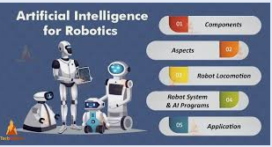

Slide 37
Artificial Intelligence, Robotics, Sensors, and Motion
Modern technologies raise new ethical challenges:
a) Artificial Intelligence (AI)
Bias in algorithms
Lack of accountability in automated decisions
Job displacement
b) Robotics
Replacement of human labor
Safety and responsibility for robot actions

Slide 38
Artificial Intelligence, Robotics, Sensors, and Motion
c) Sensors & Motion Technologies
Surveillance and loss of privacy
Tracking individuals without consent
Key Ethical Concerns
Transparency
Privacy protection
Human control over machines

Slide 39
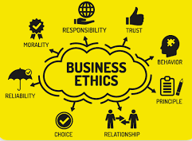

Slide 40
Business Ethics
Business ethics are the moral principles and standards that guide behavior in the business world, encompassing values like honesty, integrity, fairness, and accountability in all aspects of business operations.
Business ethics are the moral principles and standards that guide behavior in the business world, going beyond legal requirements to establish a code of conduct that drives employee behavior and builds trust.

Slide 41
Business Ethics
Business ethics as “the rules, principles, and standards of deciding what is morally right or wrong when working.” So, business ethics refers to the implementation of appropriate business practices and policies in the workplace.
There are seven principles of business ethics including
Accountability,
Care and respect,
Honesty,
Healthy competition,
Loyalty,
Transparency,
Respect for the rule of law.

Slide 42
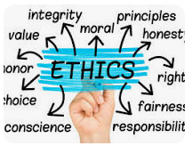
What is the purpose of the ethics?
Ethics is what guides us to tell the truth, keep our promises, or help someone in need.
There is a framework of ethics underlying our lives on a daily basis, helping us make decisions that create positive impacts and steering us away from unjust outcomes.

Slide 43
Difference between ethics, morality and laws
Ethics Definition:
Ethics, as a philosophical discipline, is the study of moral principles and the reasoning behind them.
Basis:
Ethics often involves a more systematic and rational examination of moral issues and values.
Enforcement:
Ethical principles are often implemented through codes of conduct within professions or organizations, and while they may not always be legally binding, they can have significant professional and social consequences.
Example:
A professional code of ethics might state that a doctor has a duty to "do no harm," which is a principle guiding their conduct.

Slide 44
Difference between ethics, morality and laws
Morality Definition:
Morality encompasses a set of personal or societal standards that guide behavior, defining what is considered right or wrong, good or bad.
Basis:
Morality is often rooted in cultural norms, religious beliefs, and individual values.
Enforcement:
Morality is typically enforced through social pressure, peer opinion, and personal conscience, rather than formal legal mechanisms.
Example:
A moral principle might be "honesty is always the best policy," which is a widely held belief about right and wrong.

Slide 45
Difference between ethics, morality and laws
Law Definition:
Law is a system of rules and regulations established by a governing authority to maintain order and regulate behavior within a society.
Basis:
Laws are typically enacted through formal legislative processes and are binding on all citizens within a jurisdiction.
Enforcement:
Laws are enforced through formal legal systems, including courts, police, and other law enforcement agencies, with penalties for violations.
Example:
A law might prohibit speeding, with penalties such as fines or imprisonment for those who violate it.

Slide 46


Slide 47


